Slide 1
Xrootd Monitoring
Atlas Software Week
CERN
November 27 – December 3, 2010
Andrew Hanushevsky, SLAC

Slide 2
Outline
Introduction to xrootd monitoring
What’s available
How it works
What you probably really want

Slide 3
What is xrootd monitoring?
Server-side services that report information
Two services configured via the xrootd config file
Real-time detailed monitoring
xrootd.monitor directive
Periodic summary monitoring
xrd.report directive
Details in “Xrd/Xrootd Configuration Reference”
http://xrootd.org/doc/prod/xrd_config.htm
http://xrootd.org/doc/prod/xrd_config.pdf

Slide 4
Why Two Services?
Real-time and periodic data vastly different
Each service designed for unique data requirements
Real-time data is fast paced and continuous
Setting this up is not for the faint-of-heart
Periodic data is rather leisurely but bursty
Has few requirements and is relatively easy to setup
It’s likely you will only use periodic summaries
As we shall see as we go on

Slide 5
Real-Time Monitoring Flow
Data
Collector
File
Decoder
Loader
DB
Detailed Stream
xrootd
Requests
Client
Events
Client
xrootd
Query
Rendering
RT Data
Display
DB
Meta Stream
Data
Collector
Decoder
Loader
File
DB
DB
Start Session sessionId, user, pid, client, server, start T, authinfo
FRM Staging stageid, user, pid, client, file path, stage T, duration, server
Open File fileid, user, pid, client, server, file path, open T
File I/O fileid, I/O length, offset, window T
Close File fileid, bytes read, bytes written, close T
App data user, pid, client, server, application specific data
End Session sessionId, duration, end T

Slide 6
Real-Time Data Handling Is Hard
Potentially > 50 MB/Sec monitoring stream
Needs fast data collector (i.e. monitoring server)
Part of the base package
Complex inter-related data
Needs sophisticated tools to probe relationships
Base package interfaces with mySQL
Provides basic web-interface rendering of data
This is a lot of work to put up!

Slide 7
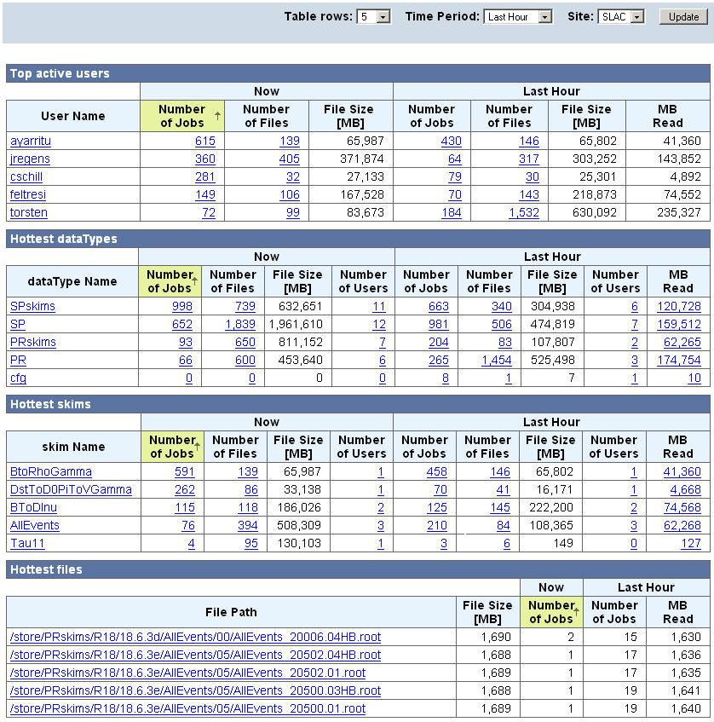
But Can Get Very Good Insights
Top
Performers
Table

Slide 8
Summary Monitoring Is Easier
Summary data periodically reported
Very large amount of data available
http://xrootd.org/doc/prod/xrd_monitoring.htm
You pick which is to be reported by category
Use the xrd.report directive
Centrally collect it via provided mpxstats tool
Merges and converts xml streams to keyword/value pairs
Feed data into your favorite monitoring system
Ganglia, GRIS, Nagios, MonALISA, etc

Slide 9
Summary Monitoring Data Flow
Xrootd version
CPU usage
Bytes In/Out
Number of Connections
Number of delays
Number of files open
Space by space token
Space by volume
Number of transactions
Number of threads
Number of requests/type
monhost:1999
Monitoring
Host
mpxstats
ganglia
Data
Servers
xrd.report monhost:1999 all every 15s
Typical Data Collected
This is a centralized data flow; you can also do a distributed flow!
Here mpxstats runs on each data server and you route data to localhost.

Slide 10
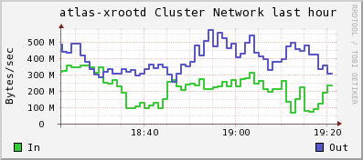
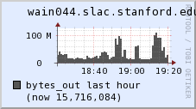
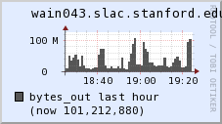
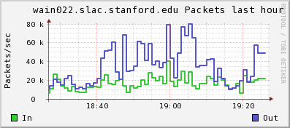
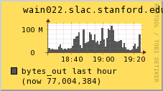
Easy To Render Basic Metrics

Slide 11
Summary
xrootd provides a wealth of monitoring data
From super detailed to basic summaries
Your needs will determine what you collect
We suggest sticking with periodic summary data
However, you must have a monitoring system
Ganglia, Gris, Nagios, MonaLisa, or other

Slide 12
Acknowledgements
Software Contributors
Alice: Derek Feichtinger
ATLAS: Charles Waldman, Wei Yang
CERN: Fabrizio Furano, Lukasz Janyst, Andreas Peters
CMS: Brian Bockelman
Fermi/GLAST: Tony Johnson (Java)
FZK: Artem Trunov
LBNL: Alex Sim, Junmin Gu, Vijaya Natarajan (BeStMan team)
LSST: Daniel Wang
Root: Gerri Ganis, Beterand Bellenet, Fons Rademakers
SLAC: Tofigh Azemoon, Andrew Hanushevsky, Wilko Kroeger
Operational Collaborators
BNL, CERN, FZK, IN2P3, OSG, SLAC, UC, UTA, UVIC, UWisc
Partial Funding
US Department of Energy
Contract DE-AC02-76SF00515 with Stanford University

